Slide 1

PaaS (Platform as a Services)
김영욱
부장/ PS / Microsoft
{YOUNGWOOK Studio}

Slide 2


Slide 3

PaaS 언제까지 랩서비스와 MPP만 팔텐가!!

Slide 4
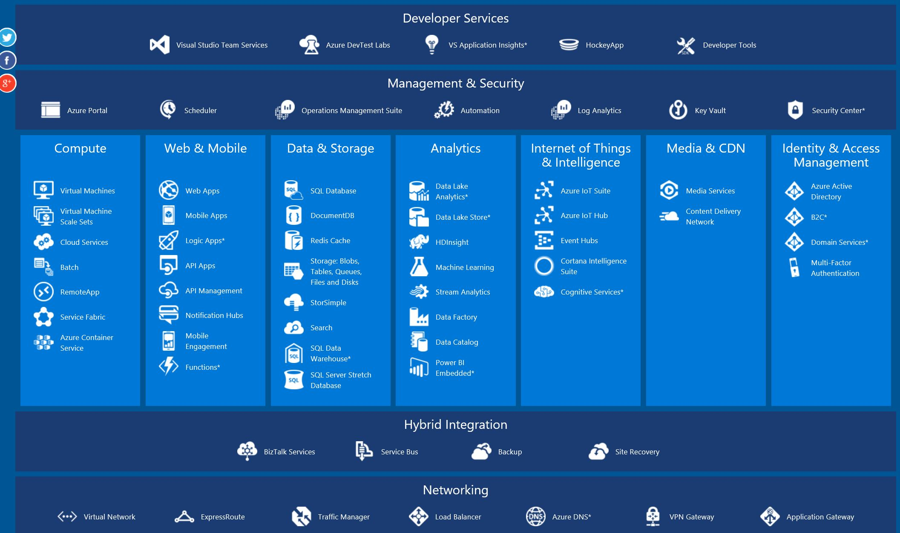

Slide 5
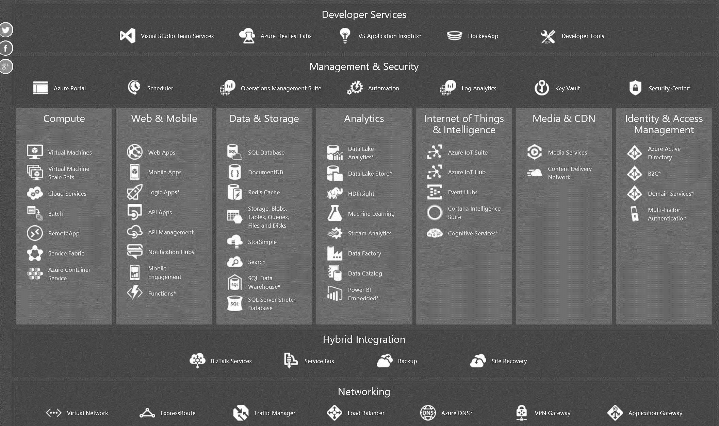
IaaS < PaaS

Slide 6


클라우드의 종류
IaaS
PaaS
SaaS
일반전산실
(자가소유)
Infrastructure
(as a Service)
Platform
(as a Service)
Software
(as a Service)
프로그램
프로그램
직접 운영
프로그램
프로그램
데이터베이스
직접 운영
데이터베이스
데이터베이스
데이터베이스
방화벽
방화벽
방화벽
방화벽
미들웨어
미들웨어
미들웨어
미들웨어
전문업체가 운영
직접운영
전문업체가 운영
O/S
O/S
O/S
O/S
가상화
가상화
가상화
가상화
전문업체가 운영
서버
서버
서버
서버
스토리지
스토리지
스토리지
스토리지
네트워크
네트워크
네트워크
네트워크

Slide 7
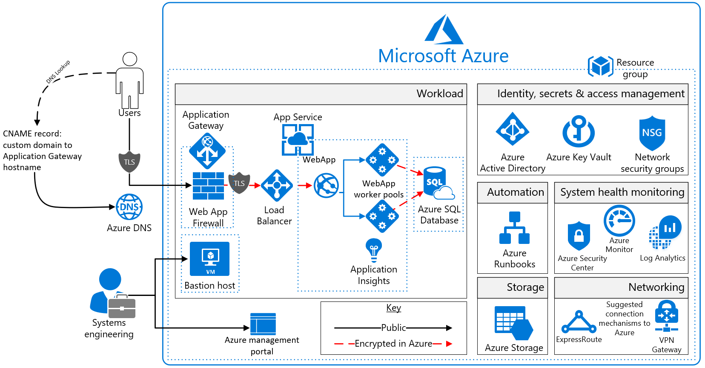

Slide 8
그럼 무얼?

Slide 9
White board Time

Slide 10
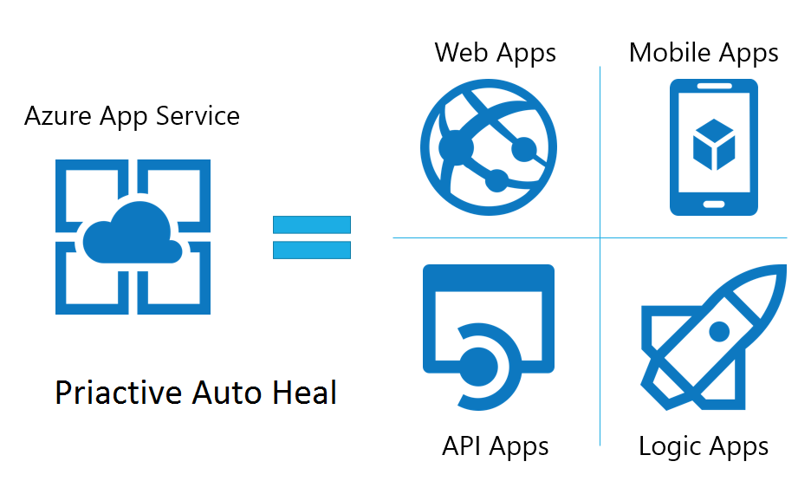

Slide 11
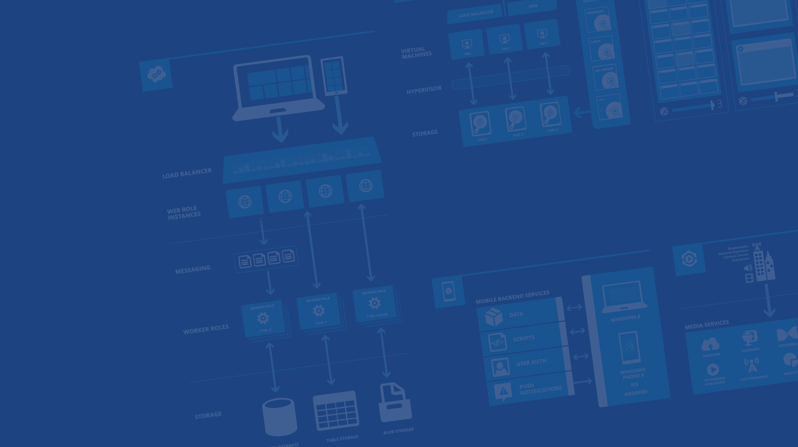
Azure Web App

Slide 12

Develop apps with…
.NET
Python
Node.js
Java
PHP

Slide 13
실습: Azure Web App
Web Server Setting
Notes:
Putty
Sudo apt-get install nodejs

Slide 14

Deployment
Choose your own (deployment) Adventure!
Visual Studio
Online
CodePlex
Git
GitHub
BitBucket
DropBox
FTP

Slide 15
실습: Github 연결
http://github.com
Notes:
Putty
Sudo apt-get install nodejs

Slide 16
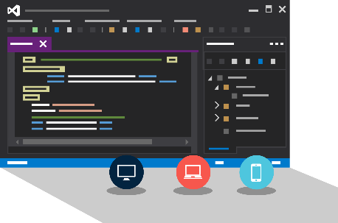
Visual Studio Code
Create Azure Resources during File / New
Create Azure Website during deploy

Slide 17
실습: PHP
Github를 이용한 배포
Notes:
Putty
Sudo apt-get install nodejs

Slide 18
Scale

Slide 19
Manual Scaling
Instance Count
1
6
Instances

Slide 20
AutoScale

Slide 21
AutoScale

Slide 22
AutoScale

Slide 23
Auto-Scaling
Instance Count
2
6
Instances
CPU
60
80
Percent

Slide 24
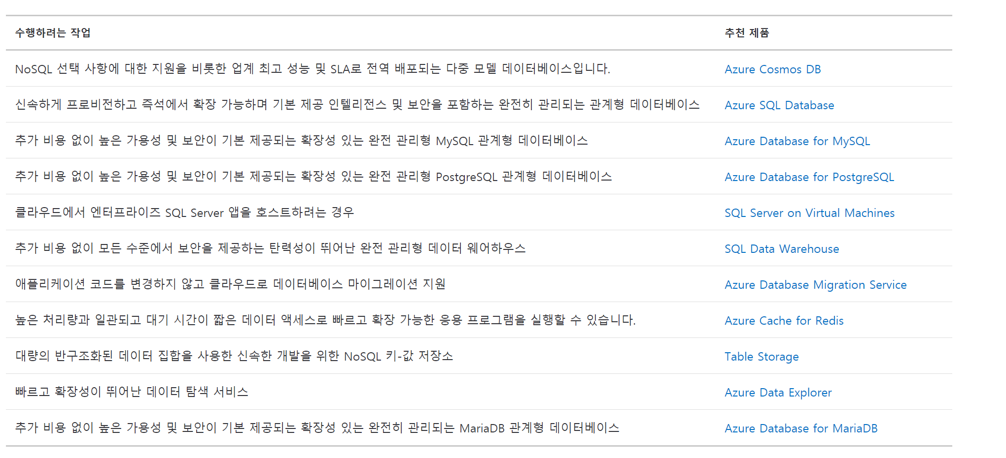
https://azure.microsoft.com/ko-kr/product-categories/databases/

Slide 25

MySQL Database
Create MySQL
Create Table in MySQL

Slide 26
실습: MySQL
데이터베이스 생성 및 PHP 프로그램과 연결
Notes:
Putty
Sudo apt-get install nodejs

Slide 27
Severless

Slide 28
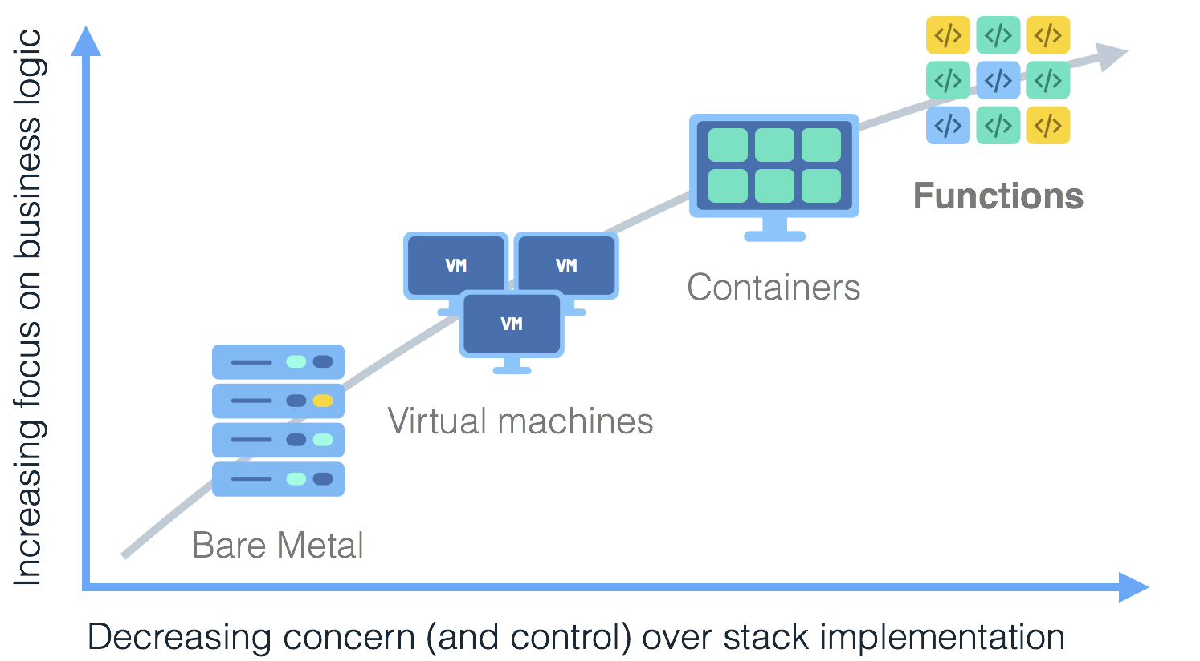
Notes:
Serverless is coming of age, developers want to focus on code instead of managing infrastructure.
Mention some of the companies.
Show the axis later.
Animate the arrow and boxes.

Slide 29
Monolithic Application
Break-down into microservices
Explosion in number of
containers / processes:
Make each micro service HA
Increase of infrastructure cost footprint
Protect against regional outages
Region A
Region B
Increase of operational
management cost and
complexity
Notes:
Managability
Load anticipation (models) and AutoScaling, Things can fail, load goes up and down.
So how about dividing your work into smaller pieces, but let the platform worry about manageability and autoscaling. Great Ideally, but its hard for the platform to scale and manage the services (So the suggestion is to make them stateless and smaller).

Slide 30
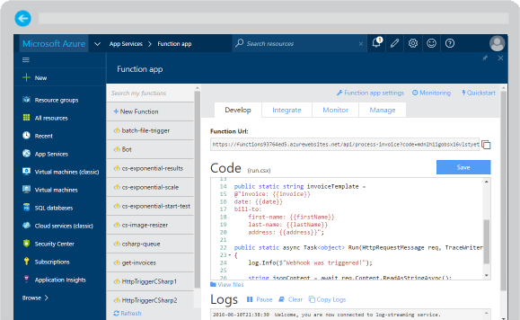
Azure Functions
Create a “serverless” event-driven experience that extends the existing Azure App Service platform by building “nanoservices” that can scale based on demand
Notes:
Azure Functions are part of the Azure Web + Mobile suite of App Services and are designed to enable the creation of small pieces of meaningful, reusable methods, easily shared across services. These serverless, event-driven methods are often referred to as “nanoservices” due to their small size. Although an Azure Function can contain quite a bit of code, they are typically designed to serve a single purpose, and respond to events in connected services.

Slide 31
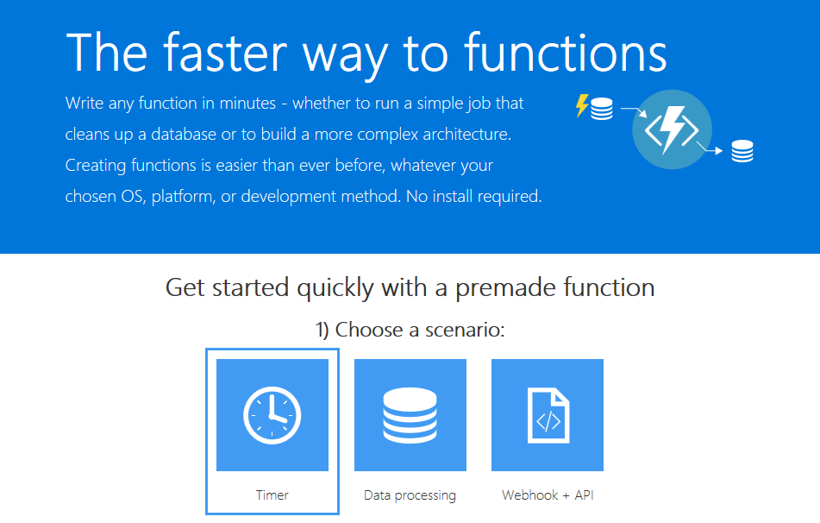
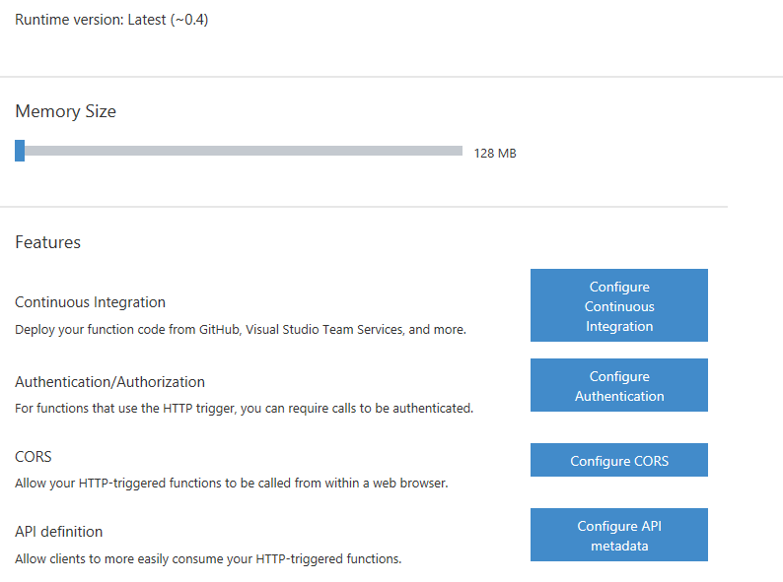
Supported Languages and Tools
Create functions in JavaScript, C#, Python, and PHP, as well as scripting languages such as Bash, Batch, and PowerShell, that can be triggered by events in Azure, third- party services, or on-premise systems
Notes:
Azure Functions can be created in most common development and scripting languages, and can be “triggered” by events in other Azure App Services, such as Web, Mobile, Logic, and API apps. Azure Functions can also be exposed via HTTP URL schemes for easy integration into legacy systems.

Slide 32

Common Scenarios
Timer-based processing
Azure service event processing
SaaS event processing
Serverless web application architectures
Serverless mobile back ends
Real-time stream processing
Real-time bot messaging
Your App or Service
Office 365
Office Graph
Azure Storage
Legacy Systems
Web Services
Other Functions
Notes:
Azure Functions are “event-driven” meaning they run based on associated and configure events, or “triggers”. For example an Azure Function could be triggered by a simple timer, such as running a process once every 24-hours, or triggered by an event in a document management system, such as when a new document is uploaded to a SharePoint library. Azure Functions can also respond to Azure-specific events, such as an image added to a Storage Blob or a notification arriving in a Message Queue.

Slide 33
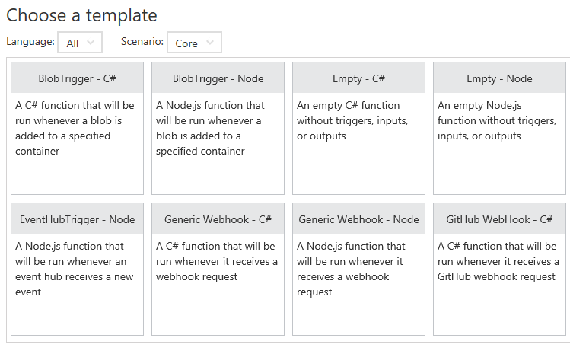
Function App Templates
Function App templates are categorized into general areas of Timer, Data Processing, and Webhook & API
BlobTrigger
EventHubTrigger
Generic webhook
GitHub webhook
HTTPTrigger
QueueTrigger
ServiceBusQueueTrigger
ServiceBusTopicTrigger
TimerTrigger
Blank & Experimental
Notes:
Although Azure Functions can be created from scratch”, the Azure Portal exposes a large number of ever-growing templates to help get developers started. These templates are typically designed with specific triggers in mind, such as a Blob Storage event, or a GitHub webhook event. Templates can easily form the basis for robust function creation, and are really designed just to get a developer started.

Slide 34
Timer Function Apps
Run at explicitly specified intervals, like every day at 2:00 am using CRON expressions, like “0 */5 * * * *“ (every 5 minutes)
Can send information to other systems, but typically don’t “return” information, only write to logs
Great for redundant cleanup and data management
Great for checking state of services
Can be combined with other functions
Notes:
Timer Functions are exactly what they sound like: Functions triggered by a specific time event. Timer Functions are perfect for clean up and maintenance processes and can easily be combined with other functions for more robust scenarios. Timer Functions us CRON expressions to configure schedules. It’s a good idea to get familiar with CRON syntax, but in the meantime there are a number of tools online to help you build CRON expressions.

Slide 35

Data Processing Function Apps
Run when triggered by a data event, such as an item being added to a queue or container
Typically have in and out parameters
Great for responding to CRUD events
Great for performing CRUD events
Great for moving content
Access data across services
Notes:
Data Processing Functions are triggered by activity in a datastore, such as a table, queue, or container. Data Processing Functions also typically have both “in” and “out” parameters, meaning they can accept an object as a parameter, and then process information and then return another object from within the function. This is not the same as a “return” value, as most Azure Functions either return void, or an HTTP response such as “created”, “accepted”, or “OK”.

Slide 36
Webhook & API Function Apps
Triggered by events in other services, like GitHub, Team Foundation Services, Office 365, OneDrive, Microsoft PowerApps
Takes in a request and sends back a response
Often mimic Web API and legacy web services flows
Typically need CORS settings managed
Best for exposing functionality to other apps and services
Great for building Logic Apps
Notes:
Webhook and API Functions are designed to easily integrate with 3rd party systems, like GitHub, Office 365, and especially Microsoft PowerApps. Since Webhook and API Functions are often exposed to external or legacy systems, they typically need CORS settings managed in order to “allow” external resources to “see” and execute the function. Most Azure Logic Apps leverage Webhook and API Functions directly.

Slide 37
Anatomy of a Function
A “Run” file that containing the function code
A “Function” file containing all service and trigger bindings and parameters
A “Project” file containing project assembly and NuGet package references
App Service settings, such as connection strings and API keys
code
Executable code
Function configuration
.NET Core and Project references
Notes:
An Azure Function is really a group of a few files that work in harmony. All actual function logic resides in a “Run” file written in a language of choice. A “Project” file is similar to a project file in other technologies such as .NET Core or Universal Windows Platform and contains “secondary” assembly references such as NuGet packages. Finally a “Function” file contains information about triggers and parameters, such as locations of Storage Queue connection strings and whether the parameter is design as an “in”, “out” or “bi-directional”. Optionally, additional configuration is also found in the Function App Settings such as an API Key or database connection string.

Slide 38
Function Bindings
Bindings serve as the basis for all connections to and from a function. Many bindings can be bidirectional as well.
Type | Service | Trigger | Input | Output
Schedule | Azure Functions | ✔
HTTP (REST or webhook) | Azure Functions | ✔ |  | ✔*
Blob Storage | Azure Storage | ✔ | ✔ | ✔
Events | Azure Event Hubs | ✔ |  | ✔
Queues | Azure Storage | ✔ |  | ✔
Tables | Azure Storage |  | ✔ | ✔
Tables | Azure Mobile Apps |  | ✔ | ✔
NoSQL DB | Azure DocumentDB |  | ✔ | ✔
Push Notifications | Azure Notification Hubs |  |  | ✔
Notes:
Without bindings, an Azure Function would just be a “disconnected” algorithm without any way to serve a purpose. Bindings server to connect functions and output to other services. Some of the most common binding types and features are listed in the table, but variations and adaptations can and do exist.

Slide 39


